Slide 1
Intuit demandforce
Texting & HIPAA Compliance in your practice
[Presented By: Liz BAKER in Partnership with RevolutionEHR]

Slide 2
TEXTING & HIPAA Compliance
Agenda
Text Messaging
HIPAA Compliance
Email & the CAN-SPAM law

Slide 3
Texting & HIPAA Compliance
TCPA (Telephone Consumer Protection Act)
Among other things, the TCPA allows individuals to file lawsuits and collect damages for receiving unsolicited telemarketing calls, faxes, pre-recorded calls or autodialed calls.
New law as of October 2013: The Federal Communications Commission (FCC) now requires that businesses obtain written consent from their consumers before delivering certain types of text or voice communications if they are transmitted for marketing purposes.
Notes:
http://transition.fcc.gov/cgb/policy/TCPA-Rules.pdf] that our customers obtain written consent from their consumers before delivering certain types of text or voice communications

Slide 4
TEXTING & HIPAA COMPLIANCE
Marketing vs. Operational
Marketing text:
Promoting certain service or product
Special offers
Recall texts
Texts without a previous business relationship between the patient & practice
Operational text:
Appointment reminder
Appointment confirmation
Any communication around a previously scheduled and agreed upon appointments

Slide 5
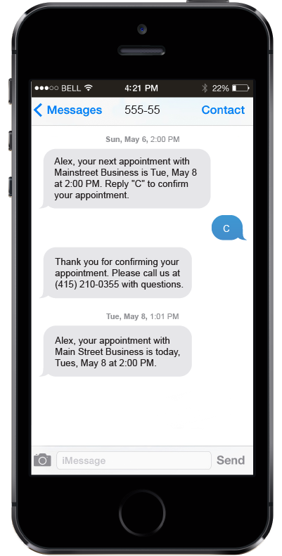
TEXTING & HIPAA COMPLIANCE
What is OK
Texts with written consent
Texts about an appointment (including confirmations & reminders)
Manually sent “Welcome” text messages
Eyewear ready notifications
Calls that are manually dialed and do not contain a pre-recorded message are exempt from the TCPA
Notes:
http://www.kleinmoynihan.com/publication/new-tcpa-rules-effective-october-16-2013/

Slide 6
TEXTING & HIPAA COMPLIANCE
What has Demandforce Done?
No more automatic welcomes

Slide 7
TEXTING & HIPAA COMPLIANCE
What has Demandforce Done?
Improved Response Tracking
Better preferences flow for patients
Expanded opt-in links: promoting text message opt-ins with every email

Slide 8
TEXTING & HIPAA COMPLIANCE
HIPAA Compliance
HIPAA Ombibus Final Rule: extended the obligations of health care providers & the businesses who have access to PHI to protect patients’ protected health information (PHI)
HIPAA Privacy Rule: governs acquisition, storage, transfer & retention of PHI
HIPAA Security Rule: covers all information acquired, maintained or transferred electronically

Slide 9
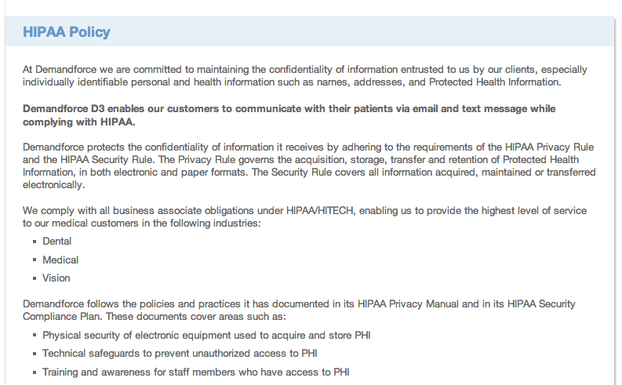
TEXTING & HIPAA COMPLIANCE
Demandforce is HIPAA Compliant
Ensure all programs in your practice are HIPAA compliant

Slide 10
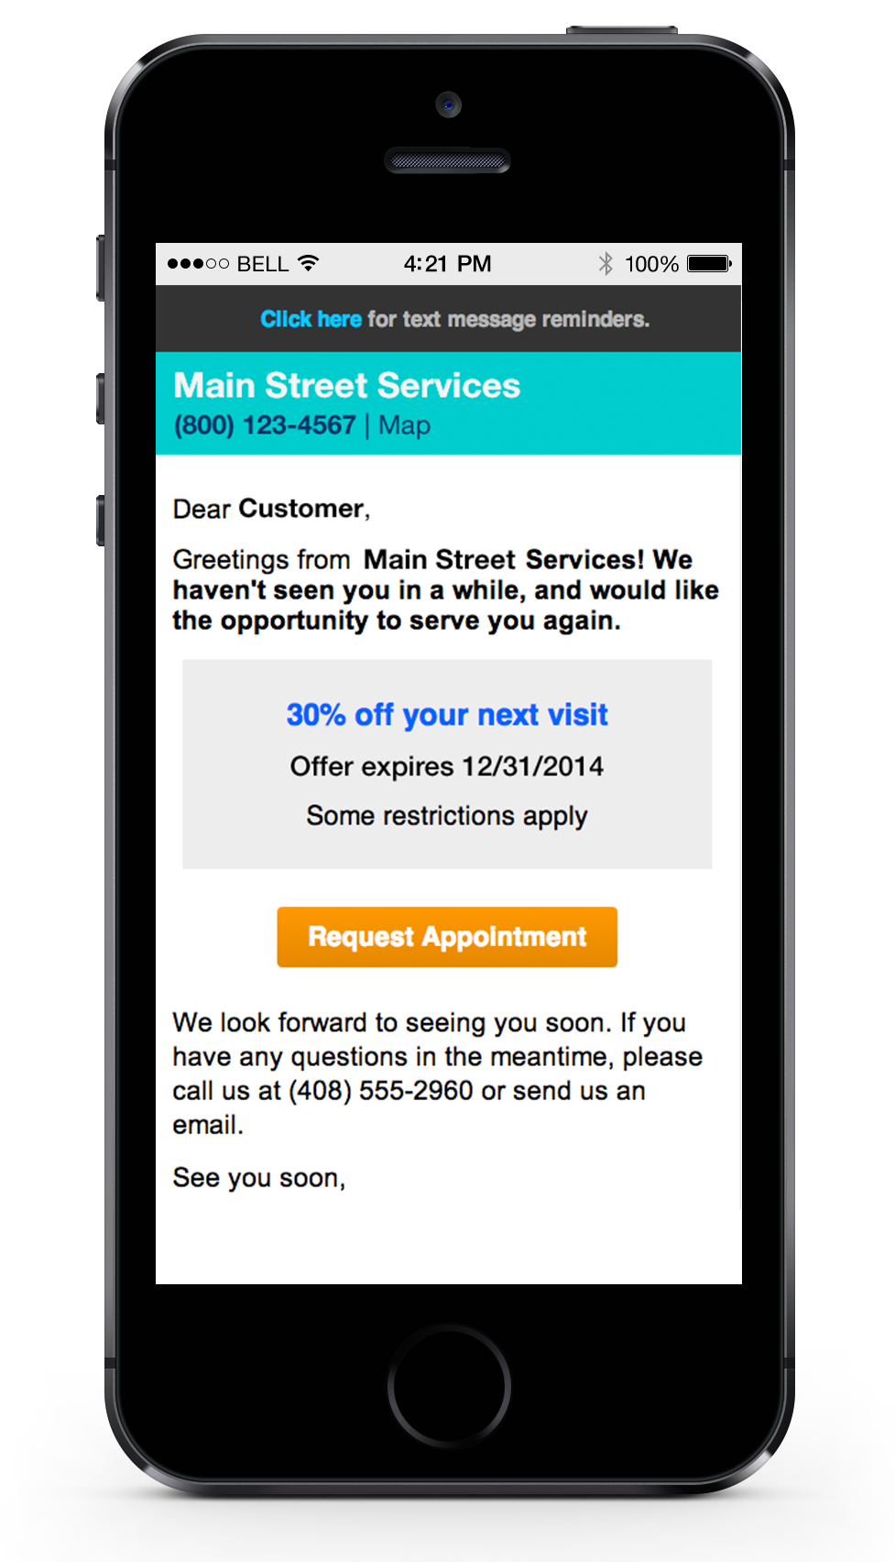
TEXTING & HIPAA COMPLIANCE
Email & CAN-SPAM Law
All emails from a business must not violate the CAN-SPAM Act
Include bulk & one-off emails
Damages ranging from $500.00 to $1,500.00 per unsolicited call/message

Slide 11
TEXTING & HIPAA COMPLIANCE
Basic Email Requirements
Include unsubscribe links
Honor unsubscribe requests
Include full contact information
Not release private or confidential information
Must not give false or misleading information (including deceptive subject lines)
** Demandforce already does the first 3 automatically

Slide 12
TEXTING & HIPAA COMPLIANCE
Liz Baker
LIZ_BAKER@intuit.com
Demandforce.com/REVolutionehr

